Slide 1

Conditions for a Simple Linear Model
Reading: 1.2
exercises: NONE
Assigned: hw 2
Producer: dr. mario
img credit: alex riegert-waters

Slide 2
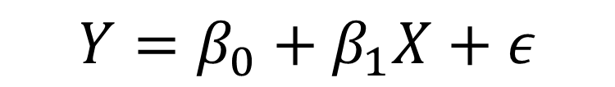
Simple Linear Regression Model
Model:
Will Not Fit Perfectly, But is It Reasonable
Goal of Model could be Description or Inference
$$Y=β_{0}+β_{1}X+ε$$

Slide 3
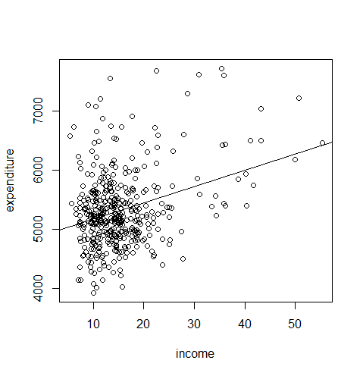
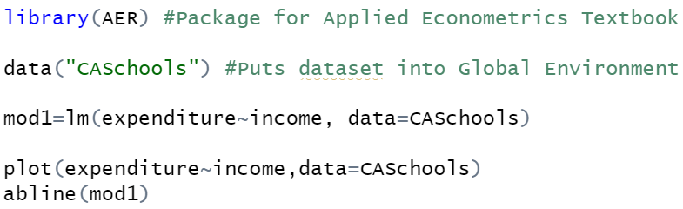
Condition About Model Form
Linearity: Assume that Y varies as a linear function of X
Advice: Always supplement your simple linear regressions with a scatterplot showing your audience the line fitted to the raw data

Slide 4
Conditions About Distribution of Errors
Zero Mean: The distribution of errors is centered at 0
Uniform Spread: The variance of Y is the same for each X (Homoscedasticity)
Independence: No relationships exist between errors

Slide 5
Conditions Necessary for Inference
Normality: Assume that the errors follow a normal distribution
Randomness: Simple random sample that is representative of the population we are trying to study

Slide 6
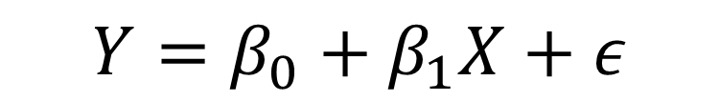
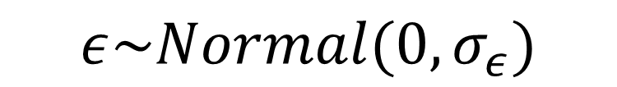
Restatement of Model
$$Y=β_{0}+β_{1}X+ε$$
$$iid$$
$$ε\sim Normal(0,σ_{ε})$$
$$iid="Independent and Identically Distributed"$$

Slide 7

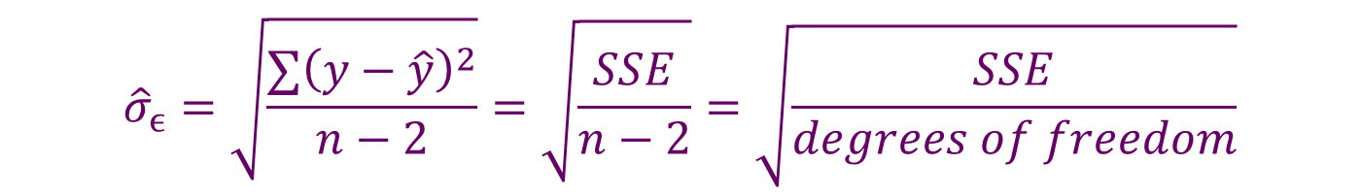
Standard Error of Regression
The Parameter $σ_{ϵ}$ Represents Standard Deviation of the Errors Around the Linear Regression Line
Standard Error of Regression ${\hat{σ}}_{ϵ}$ : Represents the “Typical” Error
Degrees of Freedom: Sample Size Minus Number of Parameters
Recall Formula for Standard Deviation (Divide by n-1)
$${\hat{σ}}_{ϵ}=\sqrt{\frac{∑{\left(y−\hat{y}\right)}^{2}}{n−2}}=\sqrt{\frac{SSE}{n−2}}=\sqrt{\frac{SSE}{degrees of freedom}}$$

Slide 8
Thank You
Make Reasonable Decisions

